Slide 1
LINK
GROUP
LINK
Automation Engineering (Shanghai) Co.,Ltd.
GROUP
霖和自动化工程(上海)有限公司
Training Record
Staff name: Nguyễn Tuấn Phong ( Assistant PLC Engineer)
Mainly training: Message System

Slide 2
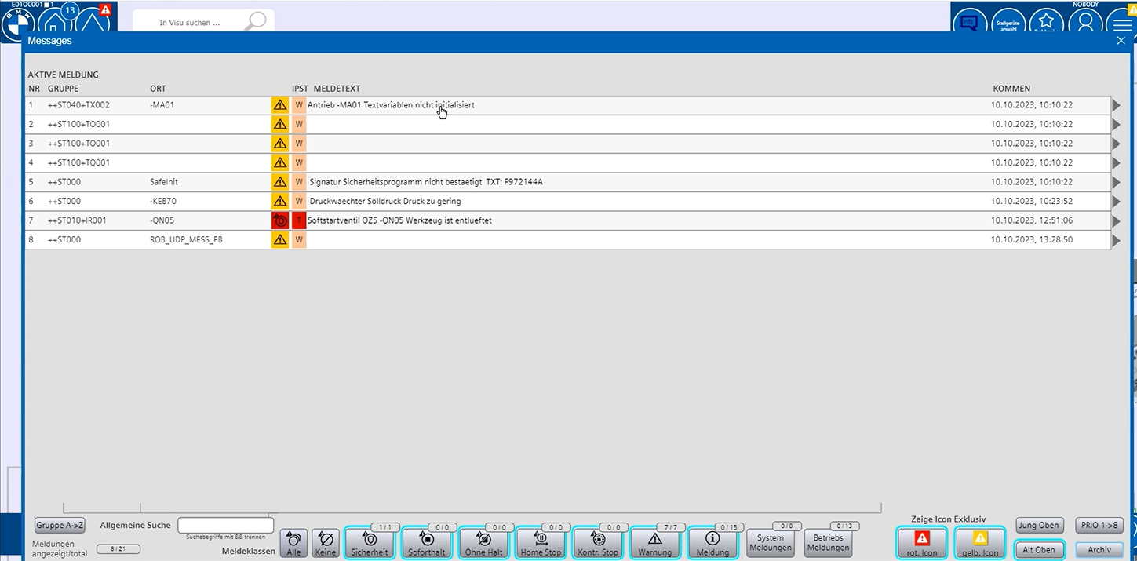
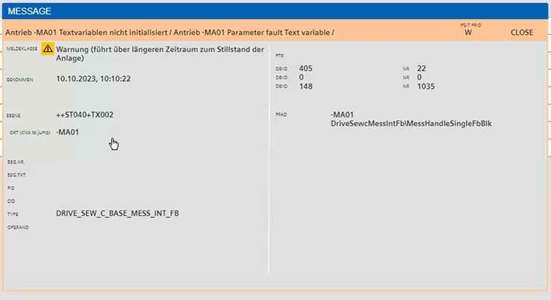
LINK
Message system
GROUP
There are two types of message lists:
Message List Error (RED):
Contains critical system error and warning messages.
Used to monitor system status and detect issues early.
Messages are sorted in chronological order.
Message List Warning (YELLOW):
Contains informational messages and system operation statuses.
Used to provide detailed information about system operation and performance.
Messages can include operational data and performance reports.

Slide 3
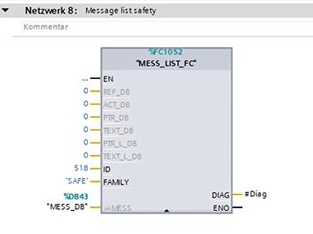
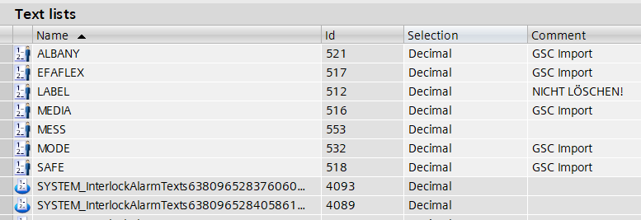
Message system
At station ST00_MESS_FB, each network will call MESS_LIST_FC (Label, type, ...). The safety messages do not have a DB, but we do have an ID.
Through the ID of the text list, we can determine which type (FAMILY) the message belongs to.

Slide 4
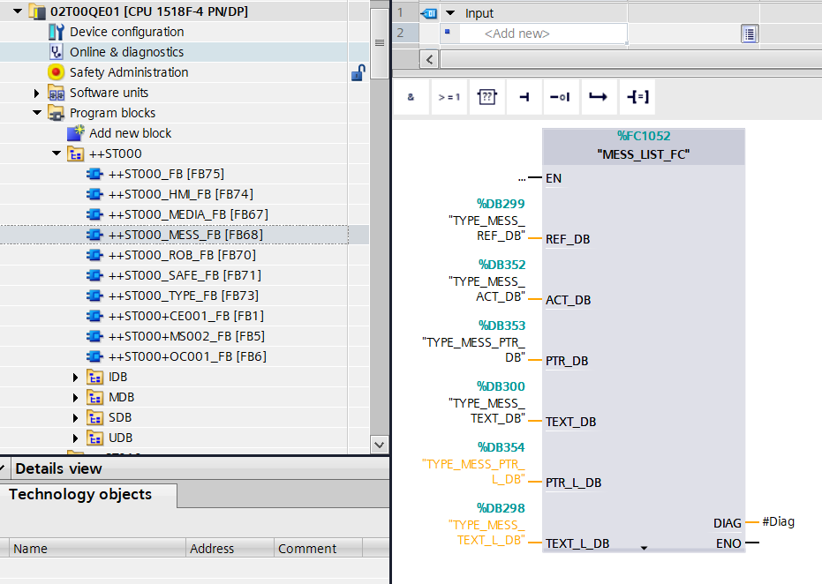
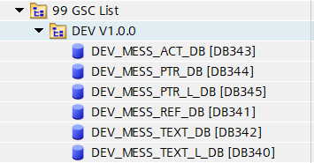
Message system
Another type of message uses a DB but does not have an ID. The reason for this is that it's based on an older standard. BMW recognized that they didn't have enough memory space in the PLC to save messages directly.
The standard GSC block list includes several DBs:
DEV_MESS_ACT_DB: Records the duration for which the message has been active.
DEV_MESS_PRT_DB DEV_MESS_PRT_L_DB.
DEV_MESS_REF_DB: References values.
DEV_MESS_TEXT_DB.
DEV_MESS_TEXT_L_DB.
The L_DB blocks are understood to be, these DBs are only saved on the memory card of the PLC and not in the RAM.

Slide 5
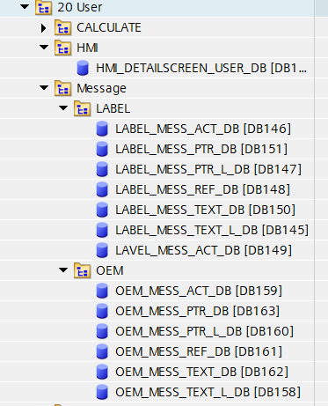
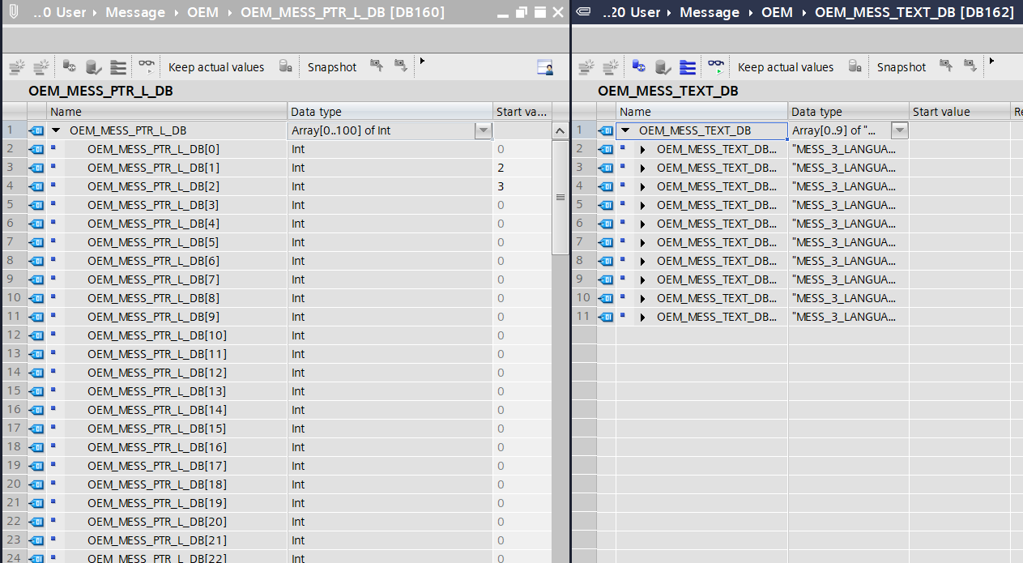
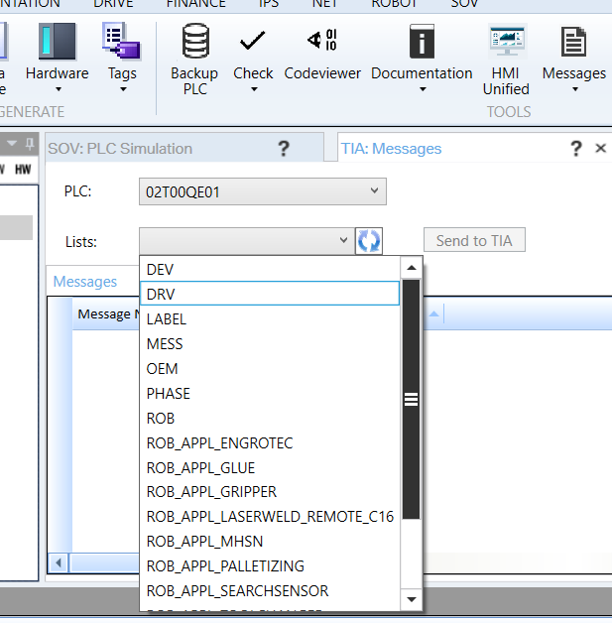
Message system
Some blocks are very large and only save a small portion of performance in the PLC. If the MESS DBs are opened, the entire cycle time will increase. Currently, the system operates as follows: only the last temporarily active message will be saved on the CPU RAM of the PLC. However, when you have 11 messages, those messages will be deleted, and the concept message system will interact with SAS. You can change, edit, add new texts, or prepare your own text list in block 20 User - MESSAGE.

Slide 6
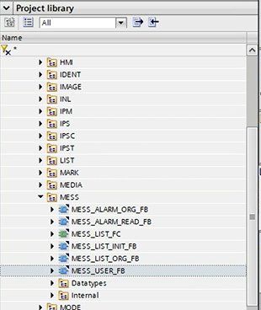
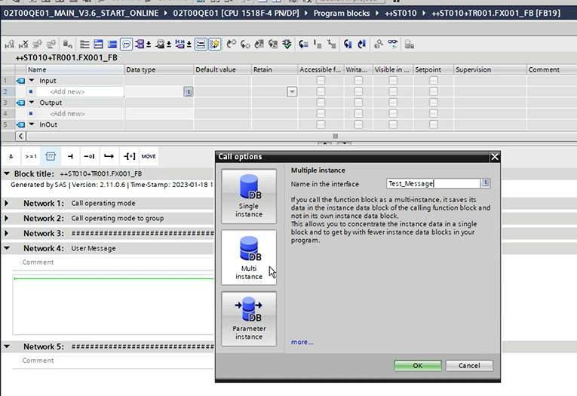
Message system
Only user list can be modify and to create your own user text list, follow these steps
1. **Open the TIA Portal**: Start the TIA Portal software and open your project.
2. **Locate the Necessary Station**: In the Project Tree, find the station where you need to set up the message.
3. **Add a Multi-Instance DB**:
- Right-click on the station or PLC where you need to add the message.
- Select "Add new block" and then choose "Data block".
- Create a new multi-instance DB, for example, name it `text_mess`.

Slide 7
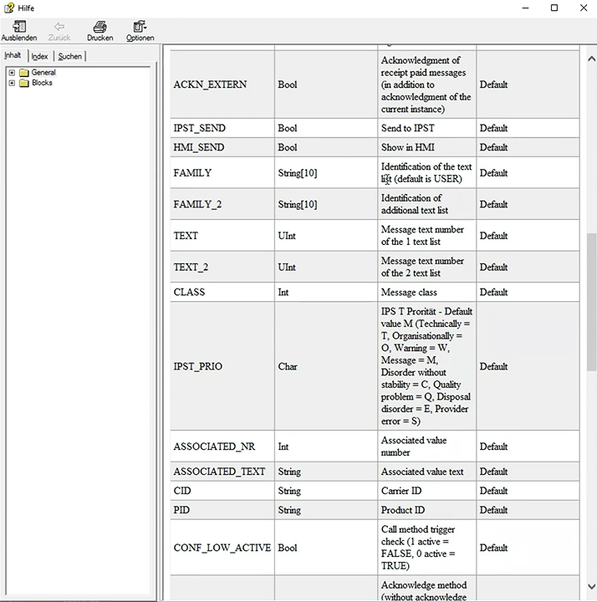
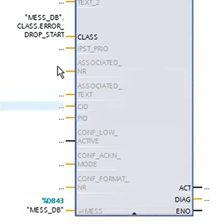
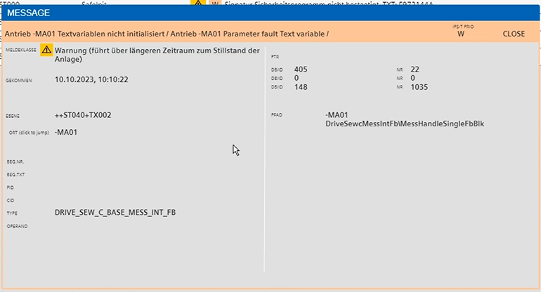
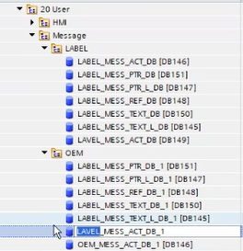
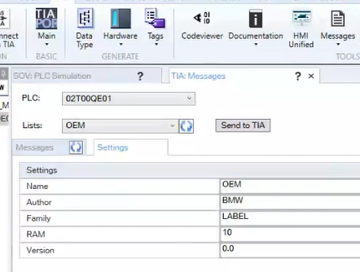
Message system
We can configure certain features of the message on the SAS through input ports and refer to, as well as define variables, in the user document (Shift + F1).
Next, we initialize our own database, we can copy from a previous database

Slide 8
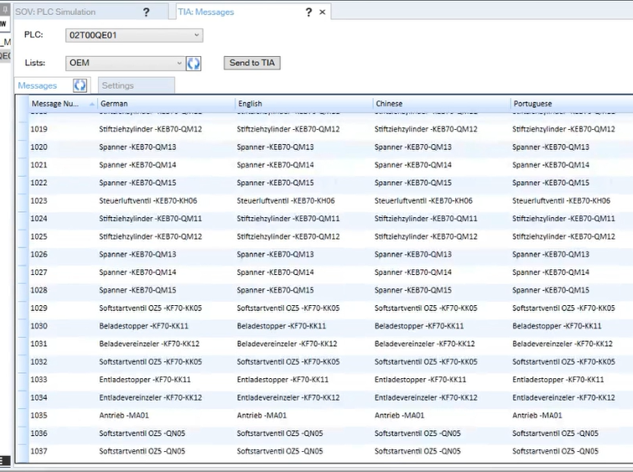
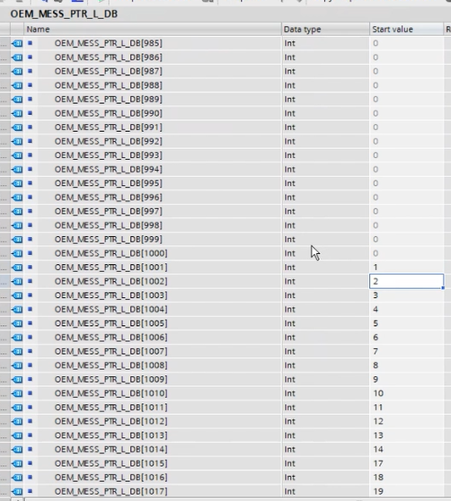
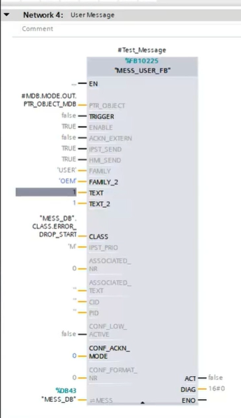
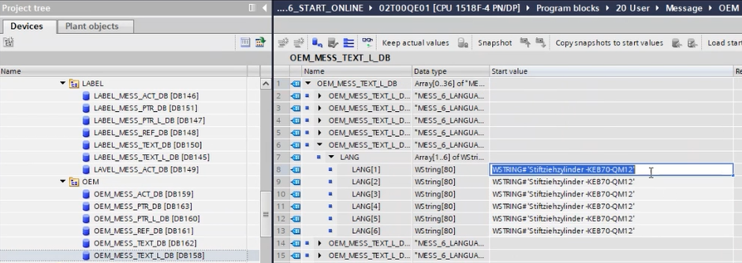
Message system
You can see in TIA a range of oscillation from 0-1037 due to the array number not requiring as much performance as a complete text list. You can modify the text according to your preferences.

Slide 9
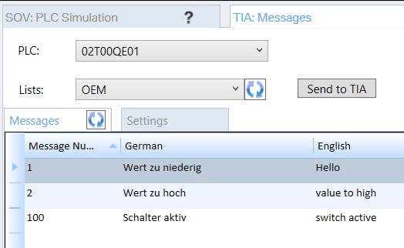
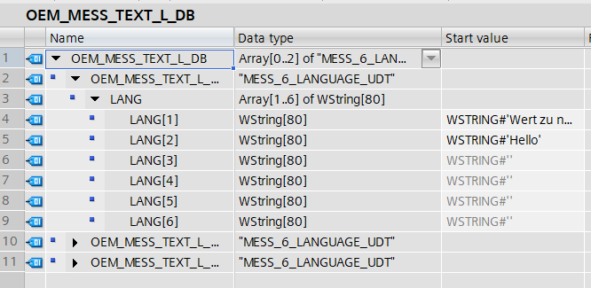
Message system
But a reasonable approach is to modify directly on SAS automatically.

Slide 10



Contact Us
LINK Group Headquarter
Shanghai, China
LINK Group North China
Shenyang, China
LINK Group Europe (LKGG GmbH)
Bad Reichenhall, Germany
Enquiry
Enquiry
Enquiry
ying.liu@LKautomation.com
kimi.wang@LKautomation.com
jackey.yin@LKautomation.com
+86 021 6918 0161
+86 021 6918 0161
+86 186 2171 9367
Sales
Sales
Sales
gene.zhang@LKautomation.com
gene.zhang@LKautomation.com
andreas.reymendt@LKautomation.com
+86 136 2179 1621
+86 136 2179 1621
Address
BLDG #D,North Jiasong Road No.3570 Jiading District,Shanghai,P.R.China
Address
NO. 14 22nd Floor,NO.168-3 Harbin Road,
Shenhe District,Shenyang,Liaoning
Province,P.R.China
Address
Fischerbraeuwiese 18b,83435 Bad
Reichenhall,Bavaria,Germany

